Slide 1

Name : Shravan Tawri
Student ID: 40168996
Assignment 1 (Capital Rideshare case) Slides

Slide 2
Background
The concept of bike sharing rides was identified as a major step towards developing a eco-friendly and sustainable system for sharing vehicles. Capital Bikeshare is a Washington-based bike-sharing program in which their users could start a ride and drop off the bike once they have reached their destination at 8635 available bike docks. Their mission is to reform the community by building a highly efficient bicycle transit system that will improve connectivity to the places where they work, play and live in. This also enabled users to travel from one place to another in an eco-friendly way, at their own convenience and at affordable prices.

Slide 3

Problem Statement
Main Questions to be answered:
Who were the riders that used Capital Bikeshare (non-members or registered members) and what insights could be derived from this data?
How do different time frames (e.g., hourly, daily, weekly, annually, seasonally) affect the total number of rides ?
Analyzing how changes in different weather aspects (e.g., Temperature, Humidity, etc.) affect the ridership patterns
How could this data be used to review the expansion plan of adding 40 new bike rental stations?

Slide 4
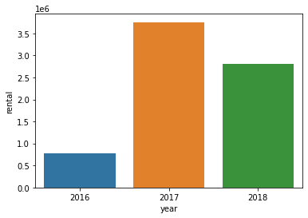
Exploratory data analysis
Year vs Annual (total) rental trips
Here we can see that the number of rentals drastically increase from 2016 to 2017 but decrease later on. However, further analysis reveals that the number of data collection days for each year is different so this data cannot be directly compared on yearly basis
Number of days of data collection in 2016 is = 92 Number of days of data collection in 2017 is = 365 Number of days of data collection in 2018 is = 273

Slide 5
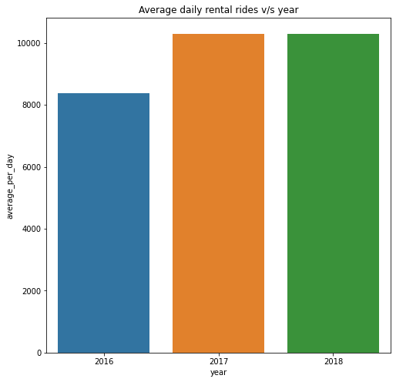
Therefore, we can try to compare the average daily bike rentals for the entire year which shows that the average daily rental increases with year

Slide 6
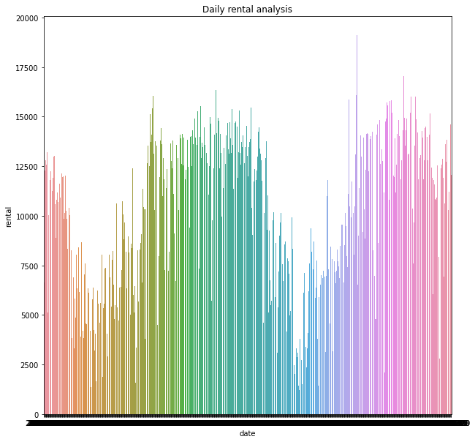
Comparison of rental rides on a daily basis.
We can observe here that there is a seasonality trend in the data. (Sinusoidal waveform with peaks)

Slide 7
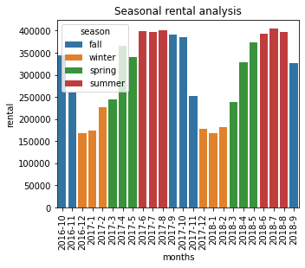
It is evident that the maximum rental usage of bikes by consumers is during the summer season. It decreases slightly during the Fall season, before declining sharply during the Winters. A general upward trend is observed after commencement of spring which peaks at Summer.
Therefore, we can conclude that seasons play a major role in deciding the demand for the bikes.

Slide 8
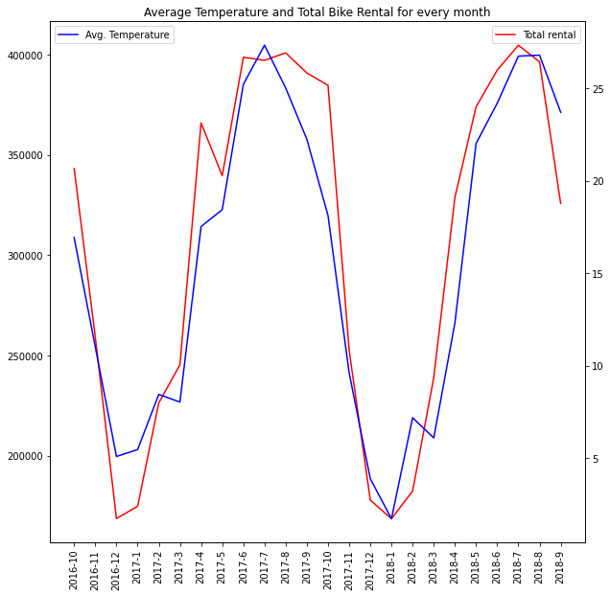
This figure represents the relationship between average temperature of the month and the total number of rentals for that month.
There is a high correlation between the monthly average temperature and total bike rental. It shows that people avoid using bicycles in Winter (when temperature go below 5 degree Celsius)

Slide 9
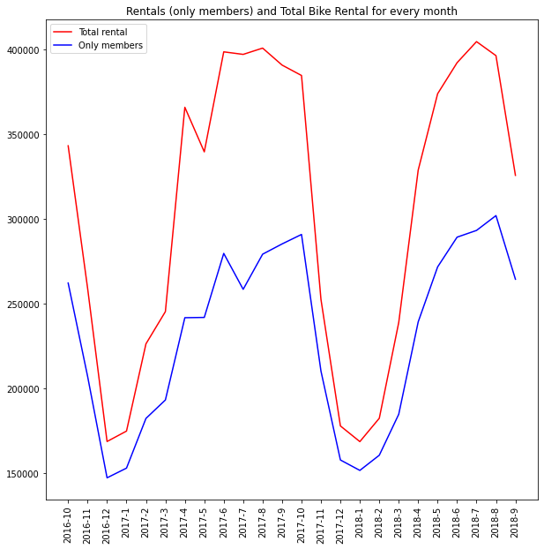
The difference between the total monthly rental rides and only members monthly rental rides is not significant for the major part of the year. However, the difference increases during Summer season i.e. the proportion of rides used by non-members is high during this period.

Slide 10
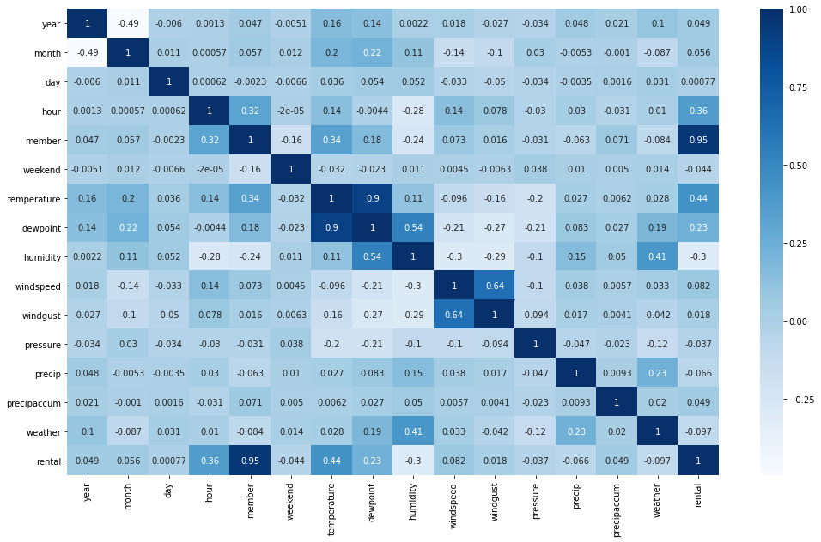


From the correlation matrix/heatmap we can see that few of the input parameters are dependent on each other (e.g Temperature and dew point etc.)

Slide 11
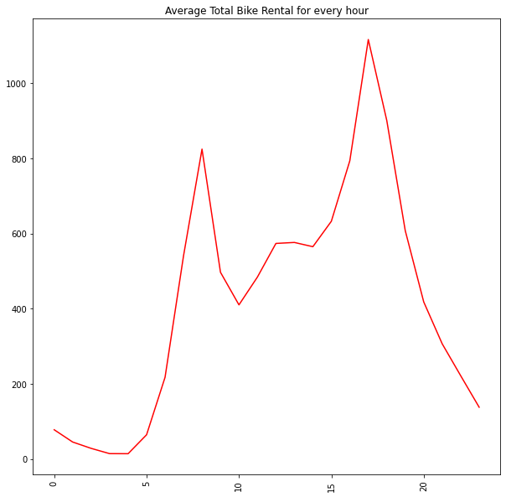
This graph shows the hourly pattern of the number of rides averaged over the entire dataset.
We can see that there are two visible peaks (at 9am and 4pm)
We can conclude that people use the bike sharing program to commute to schools/offices.

Slide 12
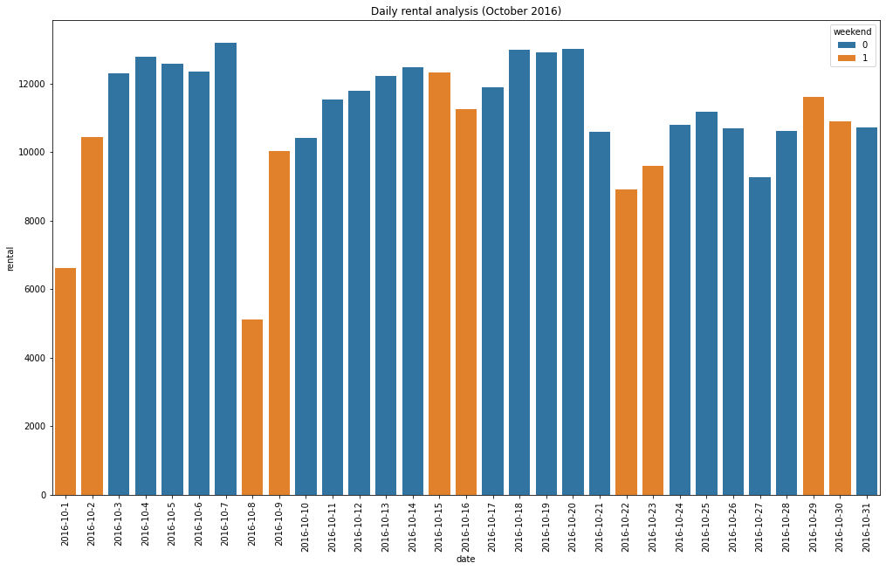
The previous conclusion can be strengthened by this graph.
It shows the comparison between the number of rides on weekdays (blue) and number of rides on weekends (yellow). The average number of rides on weekends is considerably less than on weekdays. This can be attributed to the fact that most of the schools and offices are closed on weekends.

Slide 13
Data preparation and model building
Outlier removal
Feature selection using the correlation heatmap We select the “Hour”, “Weekend”, “Temperature”, “Humidity”, “Weather and “Season” data to be the most relevant ones
One-hot encoding to convert the “Season” data (originally categorical) to numerical data.
Dividing the entire dataset into training data (80%) and test data (20%)
Using the regression models like Linear Regression, Ridge, Lasso and ElasticNet regression to predict the demand of bikes on any given particular day.

Slide 14
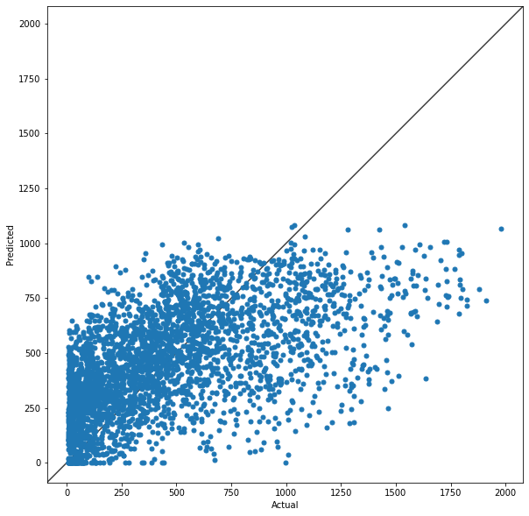
Model – RMSE
Linear – 321.84
Ridge – 322.06
Lasso – 321.84
ElasticNet – 321.83

Slide 15
Recommendation
Most number of users use the bike sharing program in Summer and Fall. So, these seasons are appropriate for any promotions/discounts to increase their customer base
Majority of the users are students/office workers who use the service to commute to office/school. So short term hourly promotions/discounts could be given to customers during the peak hours.
During summers, the proportion of non-members using the service is significantly higher than any other part of the year. So, special new membership discounts can be rolled out during this period to attract more new members.
Cost related data is required to surely tell whether the expansion plan will be profitable or not. The current data provided is insufficient

